Slide 1
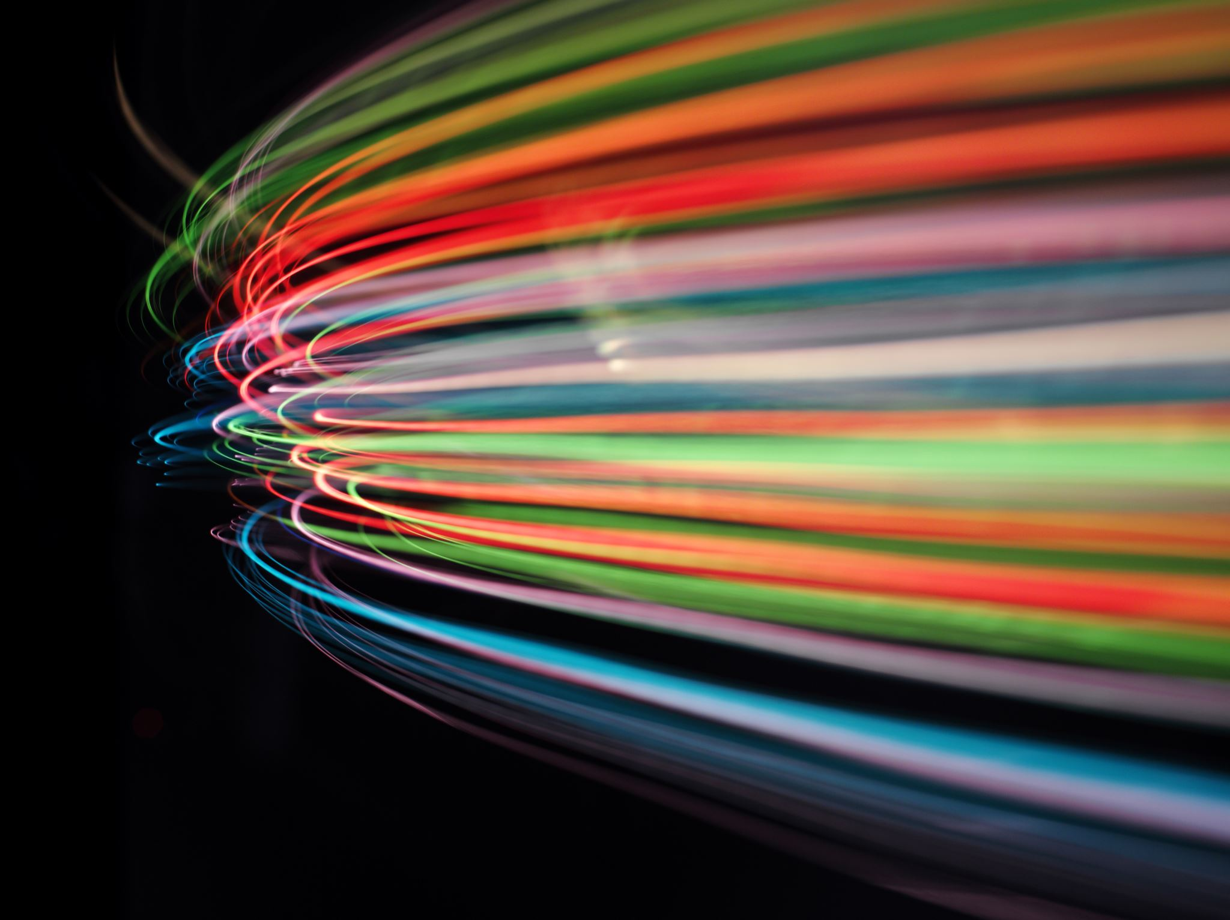
Color Recognition
ELL 205 : Signal and System
Prahlad Pallav 2019PH10647
Alok Yadav 2019PH10614

Slide 2
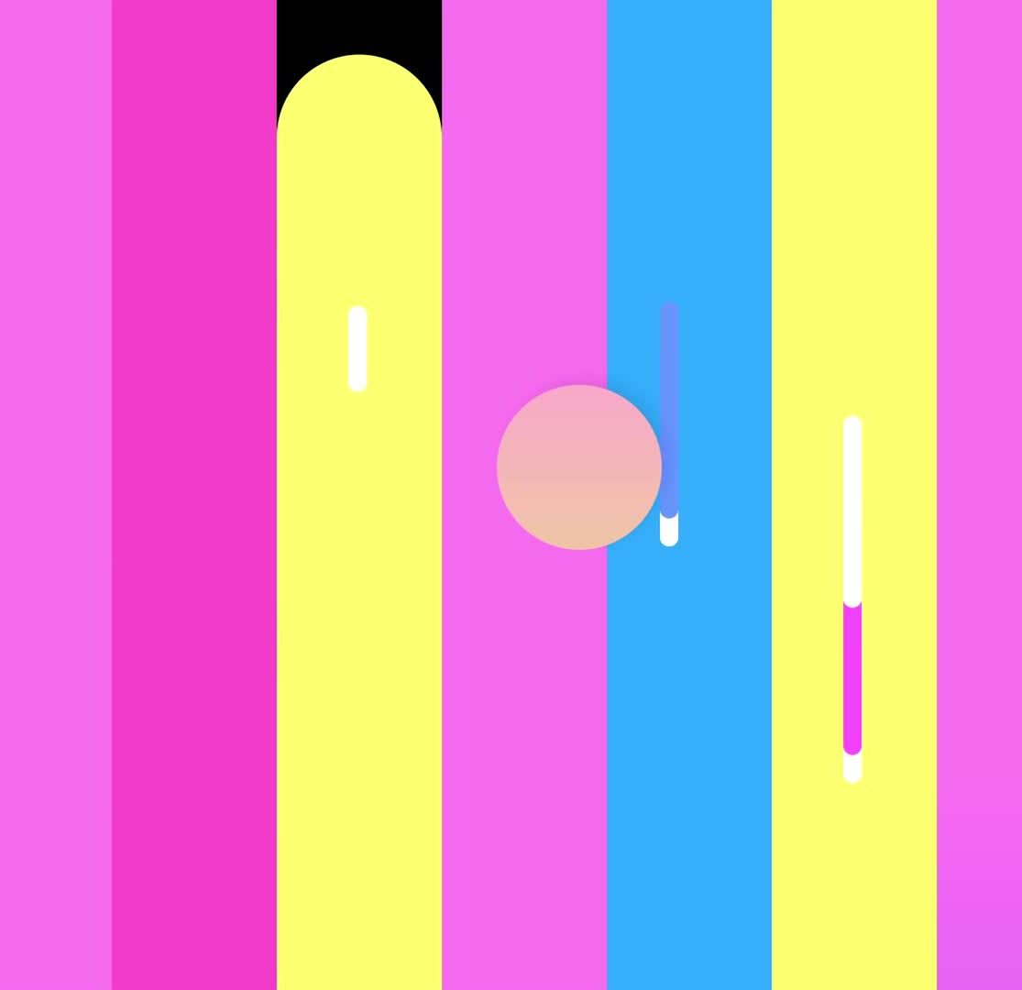
What is Color Recognition?
Color recognition is the process of detection of any color as per our need.
By recognising different color, we can do different sorts of things and it has many real-life applications.

Slide 3

OpenCV -> Open-Source Computer Vision Library
OpenCV is a huge open-source library for computer vision, machine learning, and image processing. OpenCV supports a wide variety of programming languages like Python, C++, Java, etc. It can process images and videos to identify objects, faces, or even the handwriting of a human.
Open Source
Optimized
Cross-Platform

Slide 4
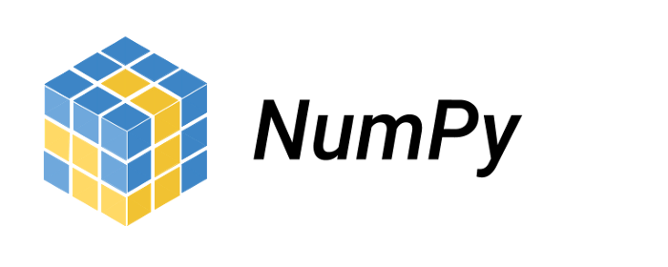
Why Numpy ?
Very similar to python list and functions in more efficient and faster way.
We can quick built advanced functionalities such as Tensorflow, Pandas.
Numpy is a general-purpose array-processing package. It provides a high-performance multidimensional array object, and tools for working with these arrays.

Slide 5
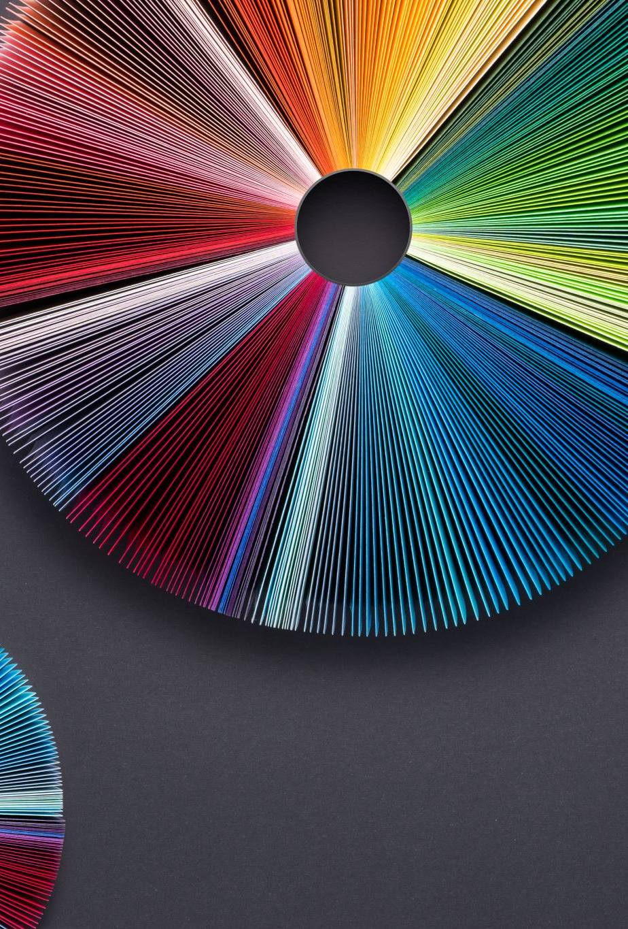
HSV -> Hue, Saturation, Value
Hue, saturation, and value are the main color properties that allow us to distinguish between different colors.
Hues are the three primary colors (red, blue, and yellow) and the three secondary colors (orange, green, and violet) that appear in the color wheel or color circle.
Color saturation is the purity and intensity of a color as displayed in an image.
Color value refers to the relative lightness or darkness of a color.

Slide 6
Steps:
Step 1
Import cv2 and numpy
Step 2
VideoCapture() -> Record real time video from webcam
Step 3
reads the input and stored in frame.
Step 4
cv2.cvtColor(frame, cv2.COLOR_BGR2HSV) -> convert the frame in BGR to HSV.
Step 5
Define the upper and lower bound to create mask.

Slide 7
Step 6
Use bitwise AND operator between frame and mask.
Step 7
imshow() -> Return an output
Step 8
waitKey() -> An interrupt is required to break out the function
Step 9
release() -> the camera port got released, no longer in work.
Step 10
destroyAllWindows()-> it kills all the window

Slide 8
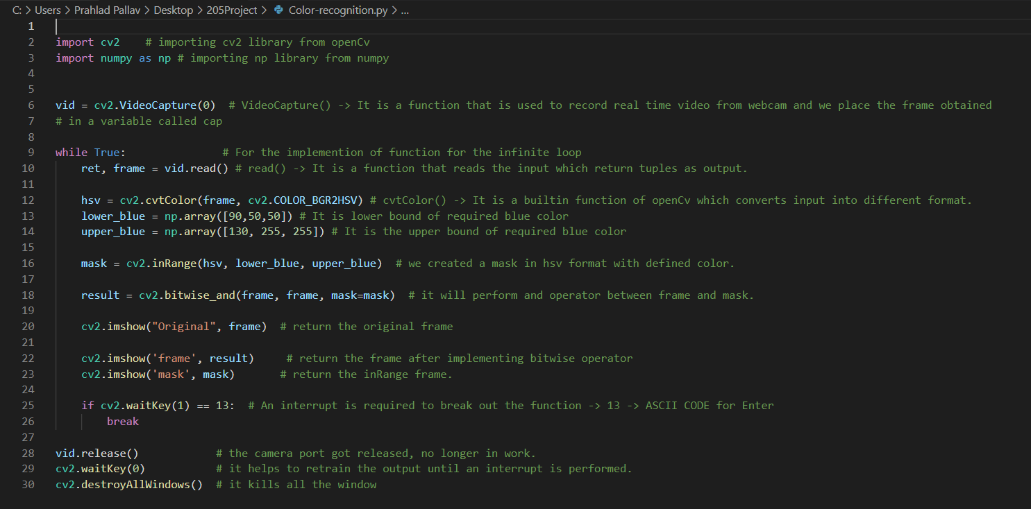

Slide 9
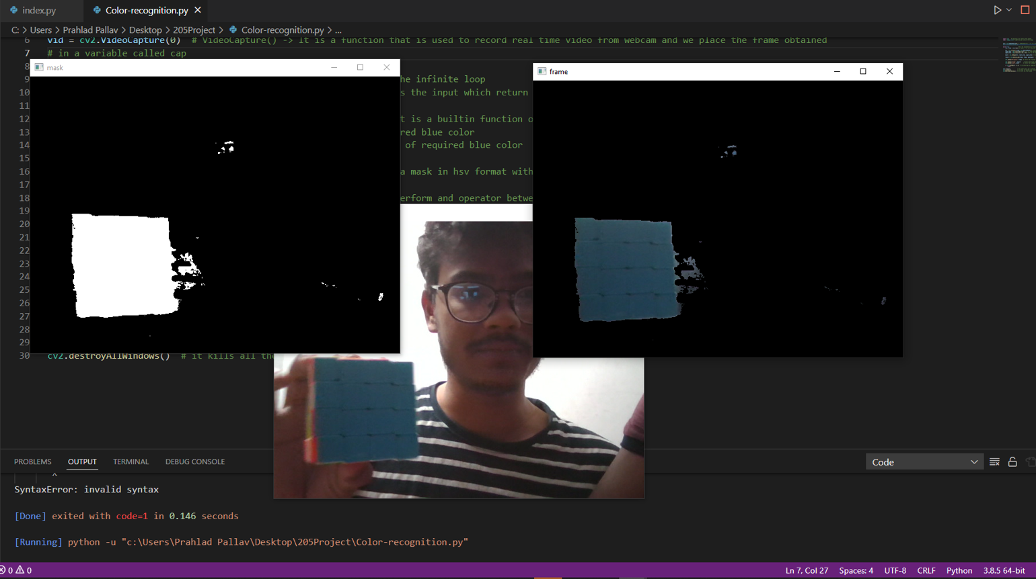

Slide 10
Some Real-world Applications
Face Recognition.
Biometric Detection.
Medical Diagnosis.
In self-driving car, to detect the traffic signals.

